Slide 1
More Graph Problems / Complexity Theory

Slide 2
More Graph Problems
Can you trace a path through this graph that travels along each edge exactly once?
Can you trace a path through this graph that visits each vertex exactly once?
Petersen Graph

Slide 3
Eulerian Paths
Given a graph G, is it possible to construct a path (or a cycle, i.e. a path starting and ending on the same vertex) that visits each edge exactly once?
6
1
2
8
5
3
9
7
3
2
4
10
1
11

Slide 4
Eulerian Paths
Given a graph G, is it possible to construct a path (or a cycle, i.e. a path starting and ending on the same vertex) that visits each edge exactly once?
NO SOLUTION!
Seven Bridges of Königsberg

Slide 5
Eulerian Paths
Key fact: there is an Eulerian circuit (or cycle) if and only if all vertices have even degree.
Intuition: If all vertices have an even degree, when you arrive at a vertex you must also have a way out.

Slide 6
Eulerian Paths
Key fact: there is an Eulerian circuit (or cycle) if and only if all vertices have even degree.
Intuition: If all vertices have an even degree, when you arrive at a vertex you must also have a way out.
There will still be an Eulerian path if exactly 2 of the vertices have odd degree
1
2
4
3
5
6

Slide 7
Eulerian Paths
Key fact: there is an Eulerian circuit (or cycle) if and only if all vertices have even degree.
Intuition: If all vertices have an even degree, when you arrive at a vertex you must also have a way out.
There will still be an Eulerian path if exactly 2 of the vertices have odd degree
Algorithm:
Start at any vertex v, and start walking a path until you return to v (keeping track of which edges have been used).
If any vertex u along your path still has unused edges, go back to step 1 and find a circuit starting at u, then add that new path in the middle of the first path where u was reached.
Continue until no more vertices have unused edges
Runtime: O(|E|)

Slide 8
More Graph Problems
Can you trace a path through this graph that travels along each edge exactly once?
Can you trace a path through this graph that visits each vertex exactly once?
Petersen Graph

Slide 9
More Graph Problems
Can you trace a path through this graph that travels along each edge exactly once? Polynomial Time Algorithm
Can you trace a path through this graph that visits each vertex exactly once?
Petersen Graph

Slide 10
Hamiltonian Paths
Given a graph G, is it possible to construct a path (or a cycle, i.e. a path starting and ending on the same vertex) that visits each vertex exactly once?
8
1
2
7
1
2
6
5
3
3
4

Slide 11
Hamiltonian Paths
Given a graph G, is it possible to construct a path (or a cycle, i.e. a path starting and ending on the same vertex) that visits each vertex exactly once?
NO SOLUTION!

Slide 12
Hamiltonian Paths
Given a graph G, is it possible to construct a path (or a cycle, i.e. a path starting and ending on the same vertex) that visits each vertex exactly once?
It turns out… we don’t know how to find these paths quickly.
Hamiltonian Paths is in a class of problems called NP-complete.

Slide 13
Complexity Theory
Computational Complexity Theory is about grouping problems by their “difficulty.”
P is the class of all yes-no problems than can be solved in polynomial time.
FP is the “functional equivalent” class, i.e. it’s not just yes-no problems
Most of the polynomial time algorithms we’ve discussed have a related yes-no version that is in P.
NP is the class of all yes-no problems for which a given solution can be verified in polynomial time.
Everything in P is in NP.
Important open problem in CS: does P=NP?
Most people think the answer is no

Slide 14
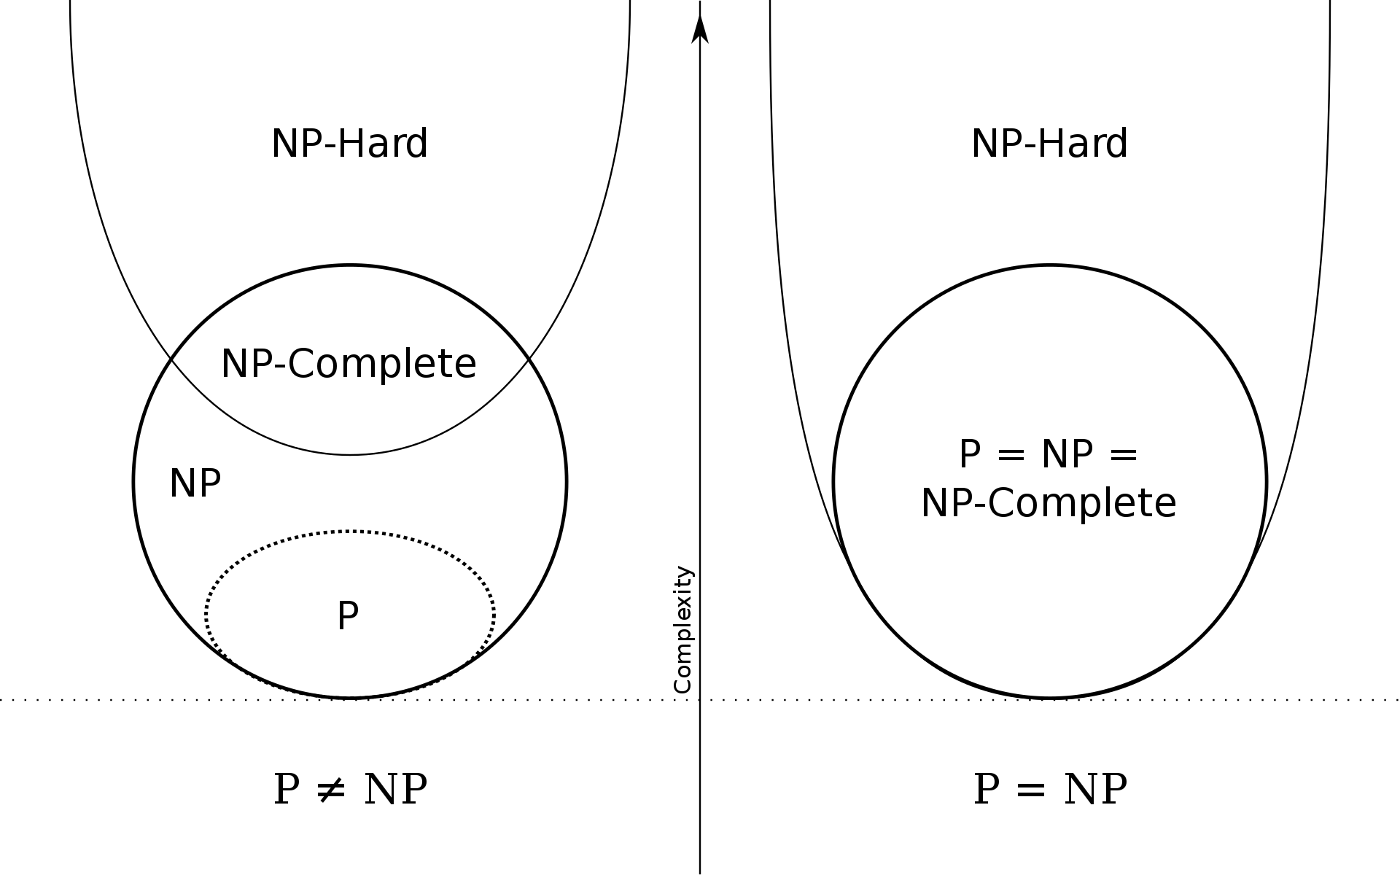
Complexity Theory
NP-hard is the class of all problems that NP problems can be reduced to in polynomial time.
i.e. if you had a solution to one of the NP-hard problems, you would effectively have a solution to the NP problems.
NP-complete problems are NP-hard problems that are also in NP.
Source: Wikipedia

Slide 15
Complexity Theory
NP-hard does NOT mean unsolvable!
It just means we don’t know whether it’s possible to solve in polynomial time.
Many NP-hard problems have reasonable polynomial approximation algorithms.
May or may not do a lecture on approximation algorithms later in the semester.
Some NP-hard problems even have reasonable pseudo-polynomial algorithms.
Recall the Knapsack problem - it has a dynamic programming algorithm for finding an exact solution in O(Wn).
Generally if you need to solve an NP-hard problem today, you’re either going to need to sacrifice time or accuracy.

Slide 16
Reductions
Transforming an instance of problem A into an instance of problem B in a way that allows the solution to B to inform the solution of A.
Or, more usefully, determining a general algorithm for doing so for arbitrary instances of problem A.
Not just a concept in complexity theory - we’ve actually already seen examples!
Recall the motivating examples for the max flow lecture: network connectivity, school dance, project management
Each of these were solved by reducing them to a max flow problem

Slide 17
Max Flow: School Dance
Boys and girls need to be paired up for the school dance, but the kids only want to be paired with someone that they know. Is such a pairing possible? And if so, what’s the pairing?
b₁
g₁
b₂
g₂
s
t
b₃
g₃
b₄
g₄
(all capacities = 1)

Slide 18
Traveling Salesman Problem
Given a list of cities and the distances between each pair of cities, what is the shortest possible route that visits each city and returns to the origin city?
The decision version is whether there exists a route whose total distance is no greater than L.
10
A
B
22
14
4
13
C
D
8

Slide 19
Traveling Salesman Problem
Given a list of cities and the distances between each pair of cities, what is the shortest possible route that visits each city and returns to the origin city?
The decision version is whether there exists a route whose total distance is no greater than L.
Seems awfully similar to Hamiltonian cycle
They’re both graph problems
They’re both looking for cycles
Biggest difference seems to be the edge weights
Idea: we know Hamiltonian cycle is NP-complete. If we can reduce Hamiltonian cycle to Traveling Salesman Problem, we’ll know TSP is NP-complete as well.
Intuitively: we know Hamiltonian cycle is hard. If it’s easy to take the solution to TSP and determine a solution for Hamiltonian, that must mean TSP is hard too.

Slide 20
Traveling Salesman Problem
Hamiltonian Cycle
G
yes/no
Polynomial time reduction
TSP solver
What’s the polynomial time reduction?

Slide 21
Traveling Salesman Problem
Given graph G = (V, E) for the Hamiltonian Cycle problem.
Create a new graph G’ = (V, V⨯V) where e(v_{i}, v_{j}) = 1 if (v_{i}, v_{j}) ∊ E, otherwise e(v_{i}, v_{j}) = 2.
Input G’ into the Traveling Salesman Solver, where we’re deciding whether a route exists with total distance ≤|V|.
The solution to this TSP will be exactly the solution to whether the original graph G contains a hamiltonian cycle.
If TSP outputs yes for G’, that means it found a path visiting all nodes while only using edges in E (otherwise it would have to use an edge with value 2 or visit a node more than once).
If a Hamiltonian cycle exists in G, then that cycle will also exist in G’ and will have total distance equal to |V|, which would have TSP output yes.

Slide 22
Traveling Salesman Problem
The reduction only involved creating G’, which can be done in polynomial time.
Therefore, the “hard part” must be in the TSP solver.
TSP is NP-hard.
TSP is in NP; given a route it’s easy to check that it is valid and has total distance ≤ L.
TSP is NP-complete.
Note that this proof relies on the assumption that Hamiltonian Cycle is NP-complete.
This is true, but we haven’t proven it here.

Slide 23
More Graph Problems
Can you trace a path through this graph that travels along each edge exactly once? Polynomial Time Algorithm
Can you trace a path through this graph that visits each vertex exactly once?
Petersen Graph

Slide 24
More Graph Problems
Can you trace a path through this graph that travels along each edge exactly once? Polynomial Time Algorithm
Can you trace a path through this graph that visits each vertex exactly once? NP-complete
Petersen Graph

